Slide 1
Super Mileage Vehicle
Andrew Breier, Anthony Mazzocco, and Blake Pahler
Advisor: Dr. Cho

Slide 2
Contribution
Team members | System subtask | Weight of contribution
Andy Breier | Script | 100%
Andy Breier | Python code | 40%
Andy Breier | Mock Mount | 10%
Blake Pahler | Python code | 40%
Anthony Mazzocco | Python code | 20%
Anthony Mazzocco | Mock Mount | 90%

Slide 3
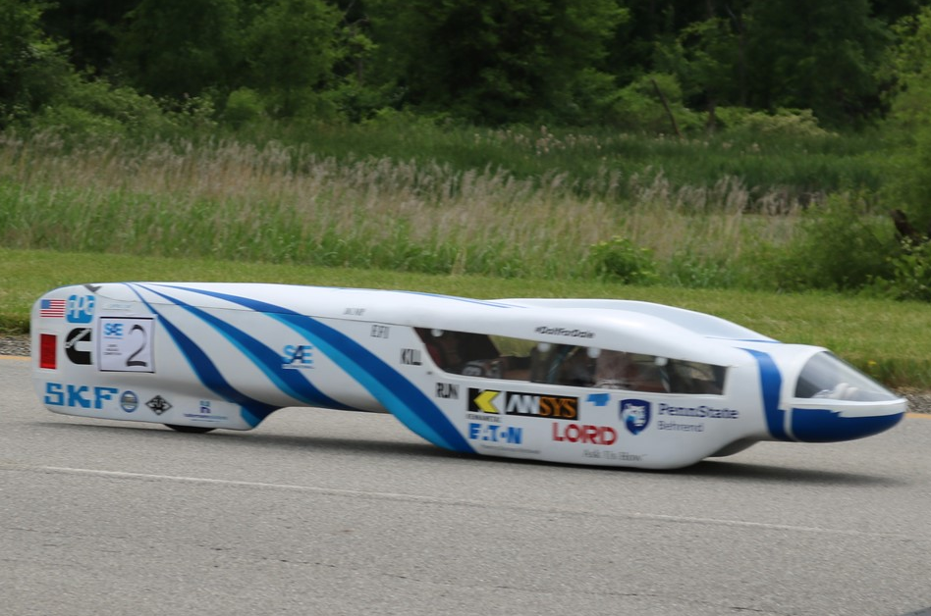
Background
Society of Automotive Engineers club (SAE)
Competition is annual
Every year the vehicle is rebuilt/improved
Change how the driver sees out of vehicle to make it safer and clearer

Slide 4
Problem
Driver Visibility with current method
Difficult to see out of sides/front
Looking between feet to see front
Material of windows
Driver gets tested before race
Usually ends up guessing numbers (unsafe on course)

Slide 5
Objective
Create a camera system with simple Operating System
Simple user interface
Use camera system so driver can see out of sides and front of car clearly

Slide 6
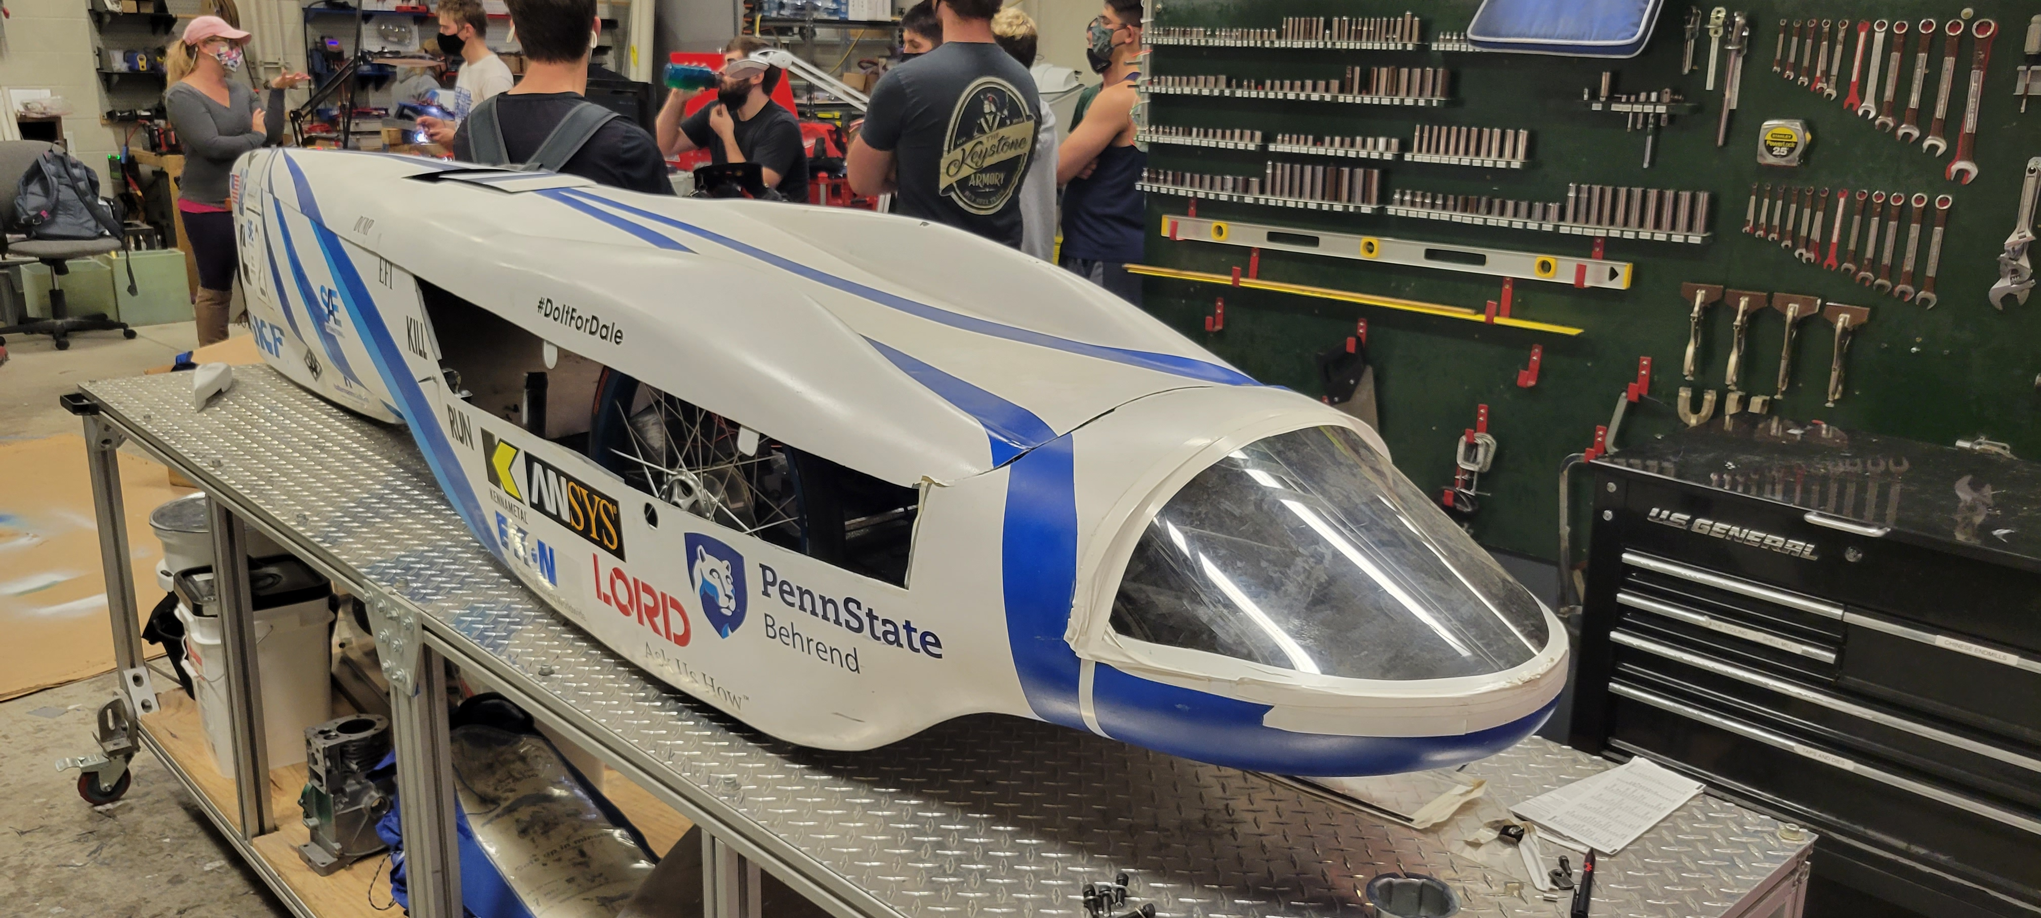
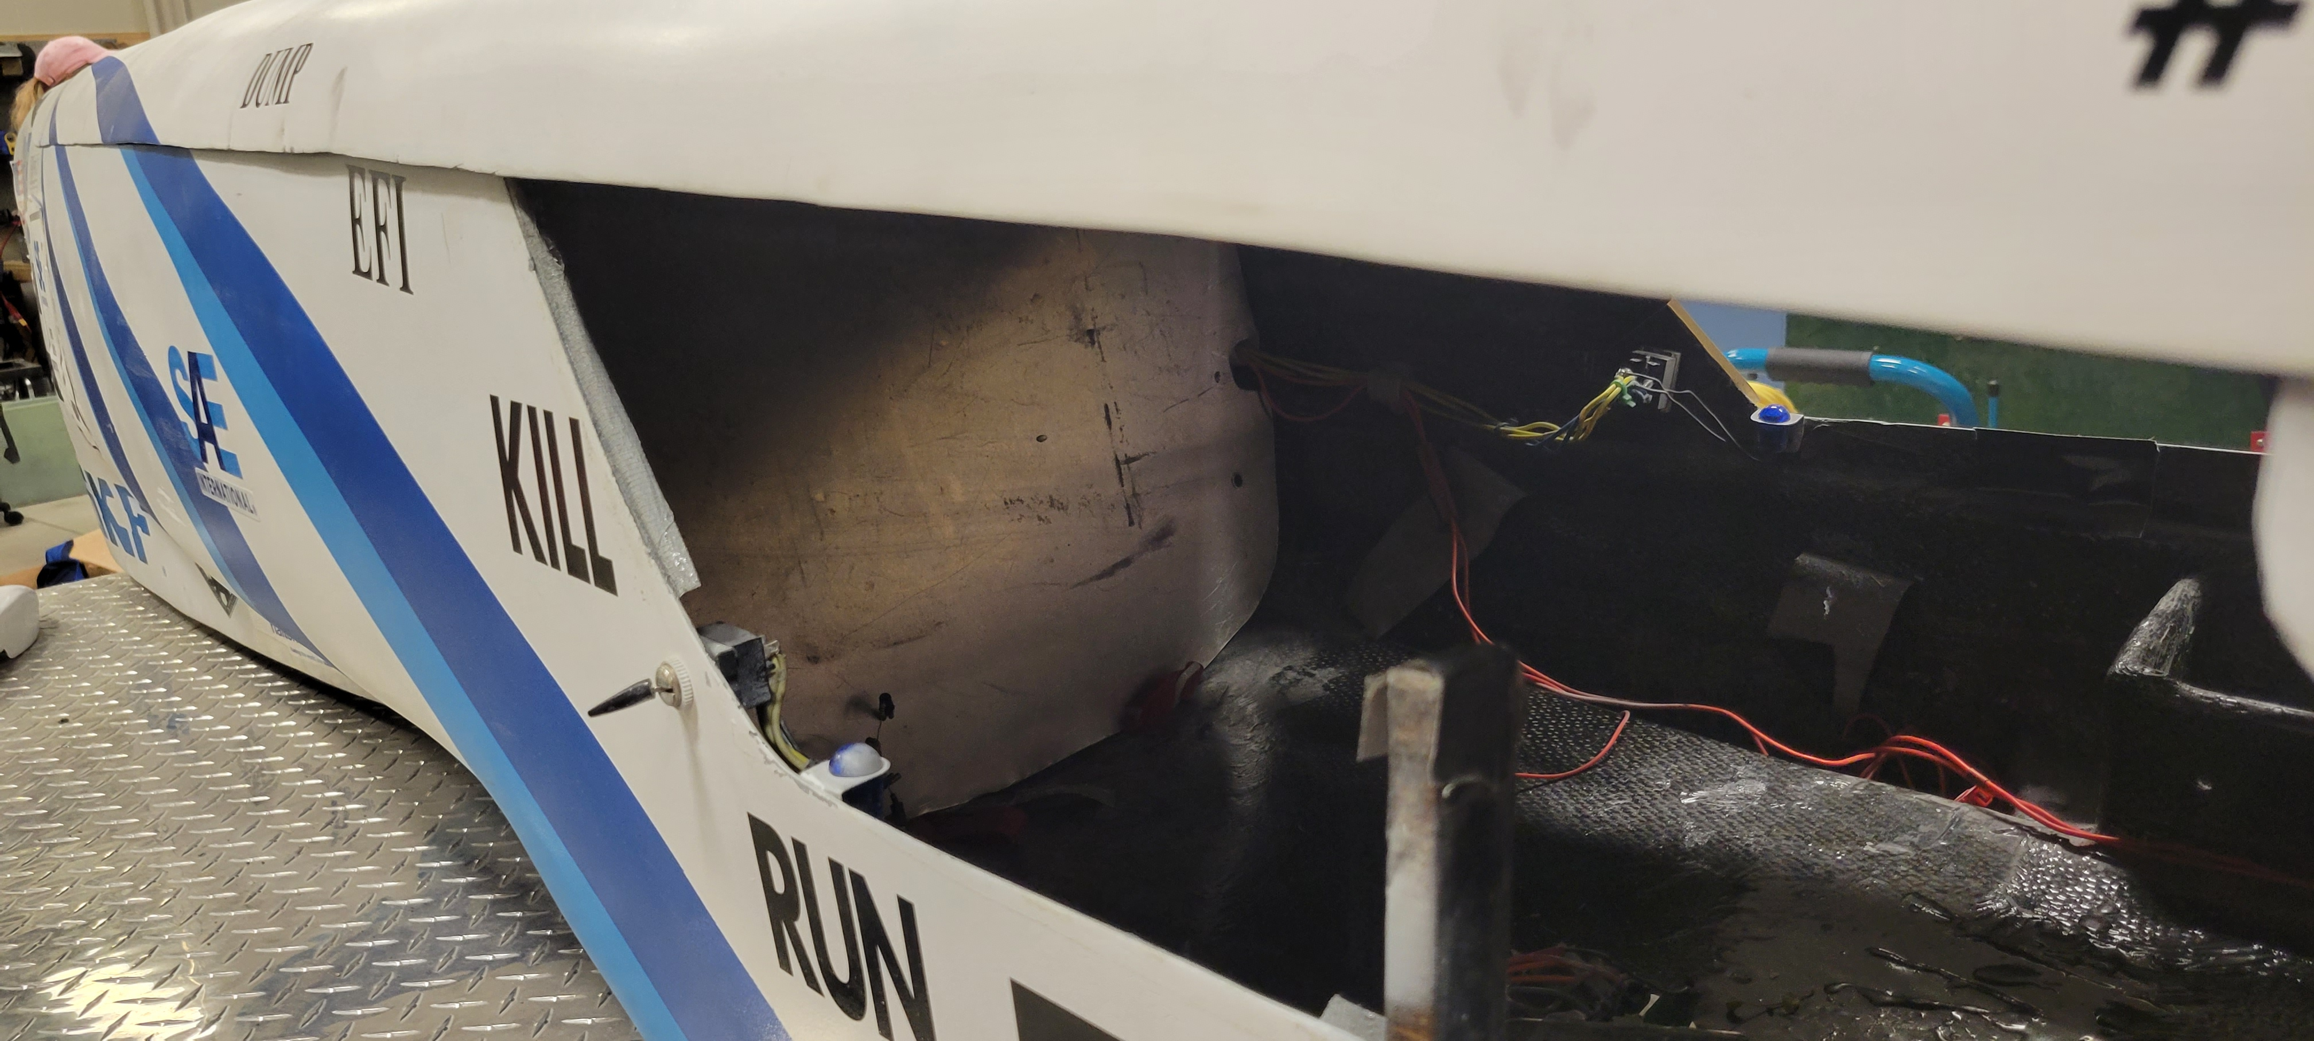
Pictures of Current SMV

Slide 7
Engineering Requirements
Must be able to see objects at least 5ft from the ground
Must be able to see objects at least 20ft in front of vehicle
Must have good resolution (720p or better)
Must be aerodynamic/Low profile cameras
Powered by a battery that is separate from any other power supplies (26,800 mAh USB power bank)
Easily Replaced/Upgraded

Slide 8
Preliminary Level 0 Design
PowerPower
Camera System
Power
Surroundings
Camera Feed

Slide 9
Preliminary Level 1 Design
Camera 1
Power
Camera 2
3.0 USB Hub
Raspberry Pi4
Monitor
Camera Feed
Surroundings
Camera 3
Power from USB Hub

Slide 10
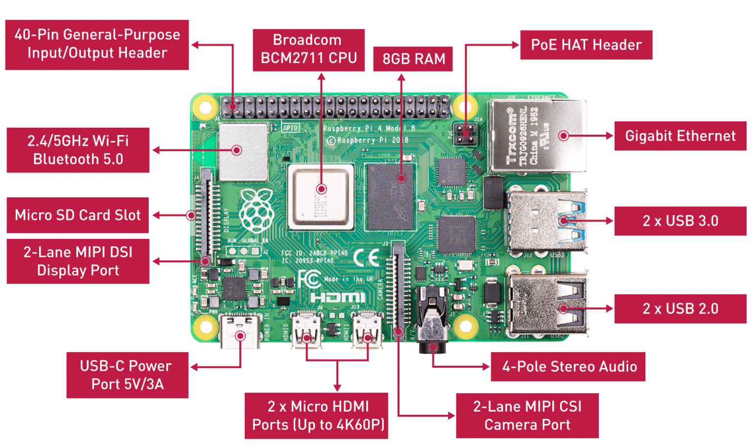
Minicomputer
Raspberry Pi 4
2x 2.0 USB ports
2x 3.0 USB ports
2x micro-HDMI ports
Can be battery powered
Uses simple interface

Slide 11

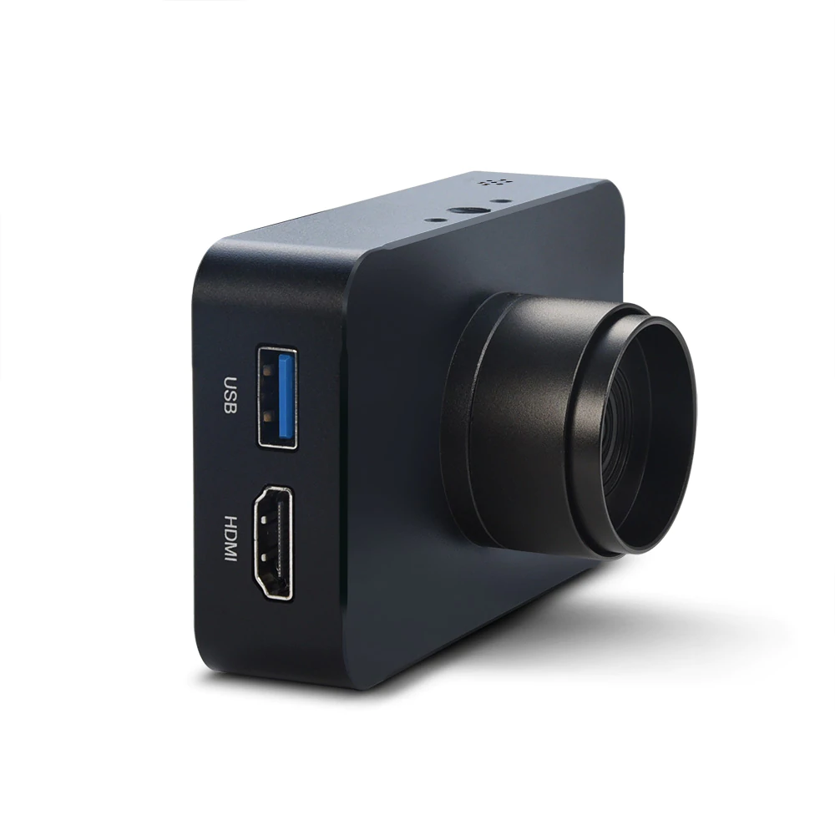
Cameras
MOKOSE 12MP HDMI/USB Camera
Low profile
Clear Image
Either use USB or HDMI
Field Of View: 85 degrees

Slide 12
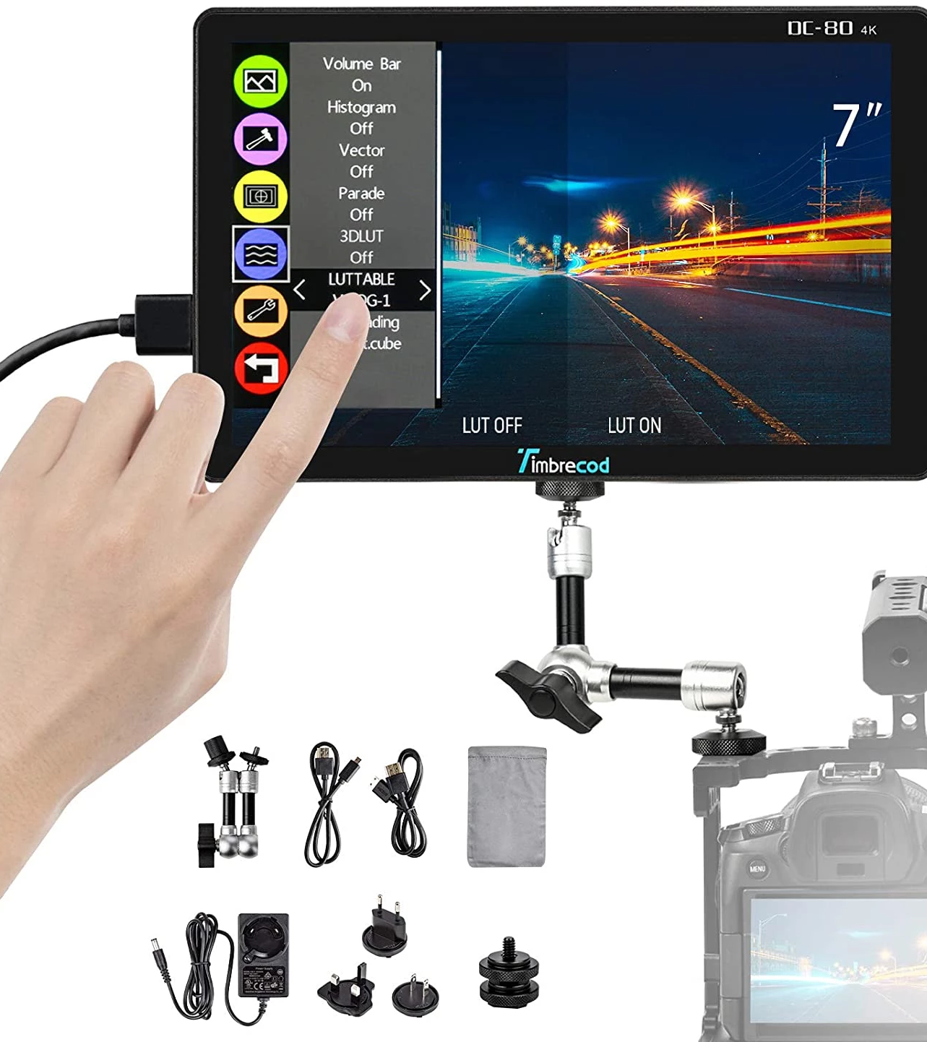
Monitors
Timbrecod 7 inch touchscreen monitor
Includes 3500 mAh Rechargeable battery
Touch Screen
HDMI input

Slide 13
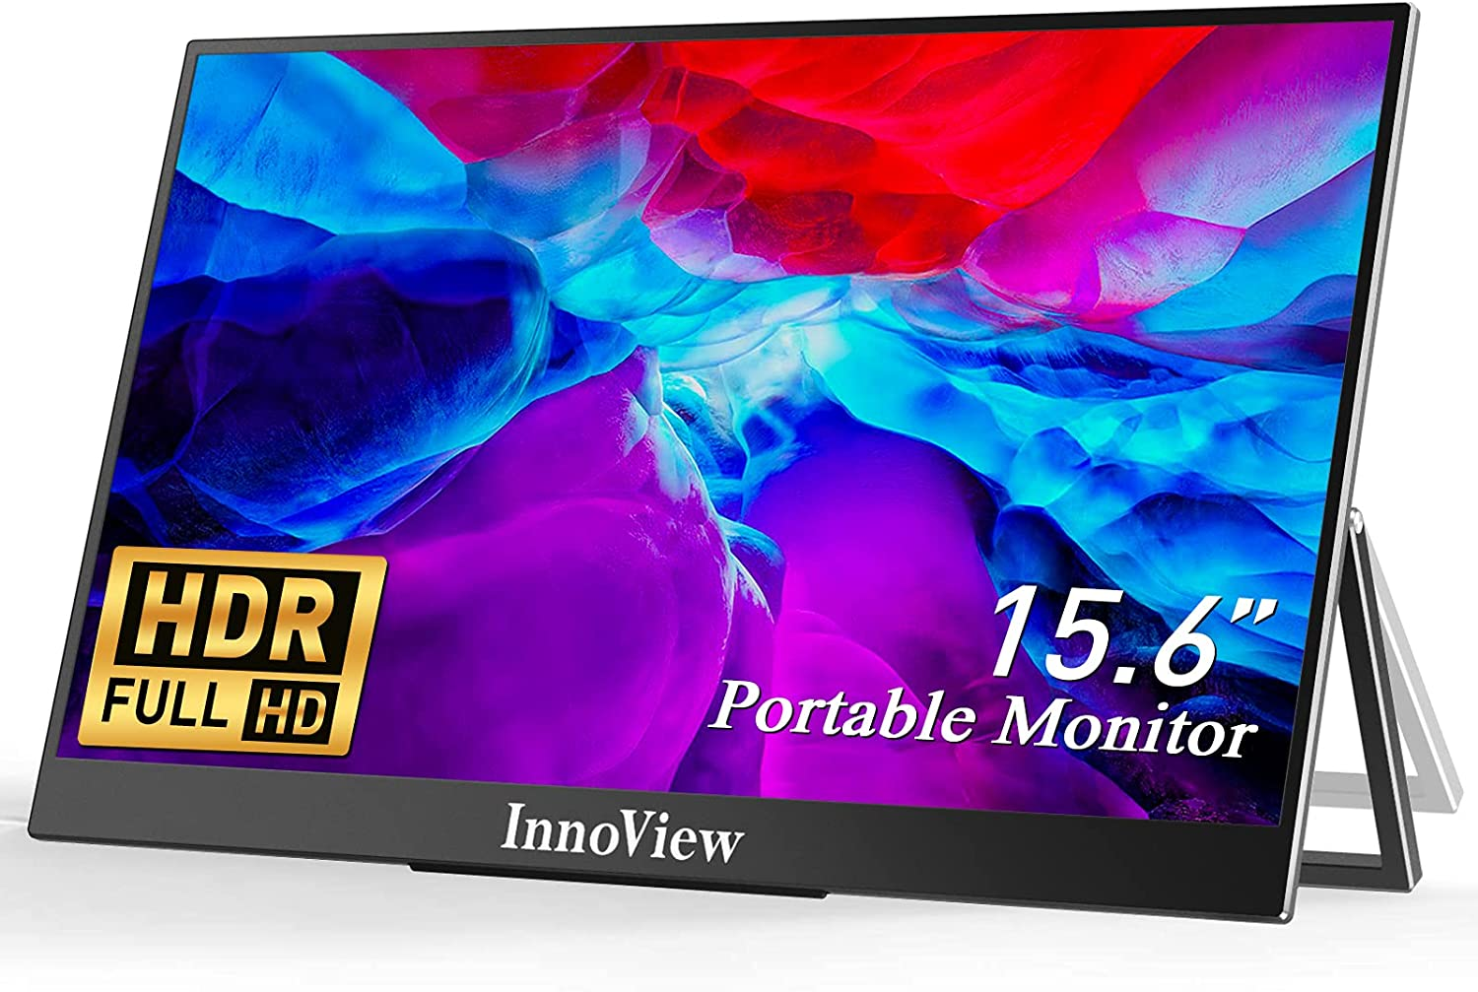
Alternative Monitor
At least 15.6-inch screen
Each window takes 1/3 of screen
5.2 inches for each window
USB Powered

Slide 14
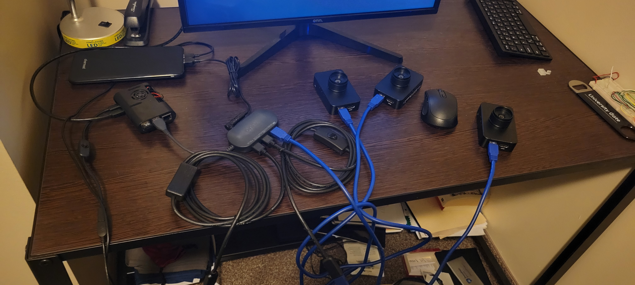
Physical Design Photos

Slide 15
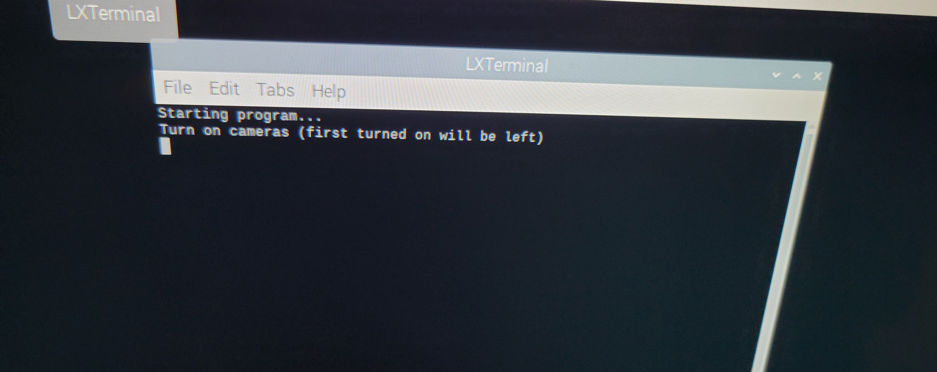
LXTerminal Script

Slide 16
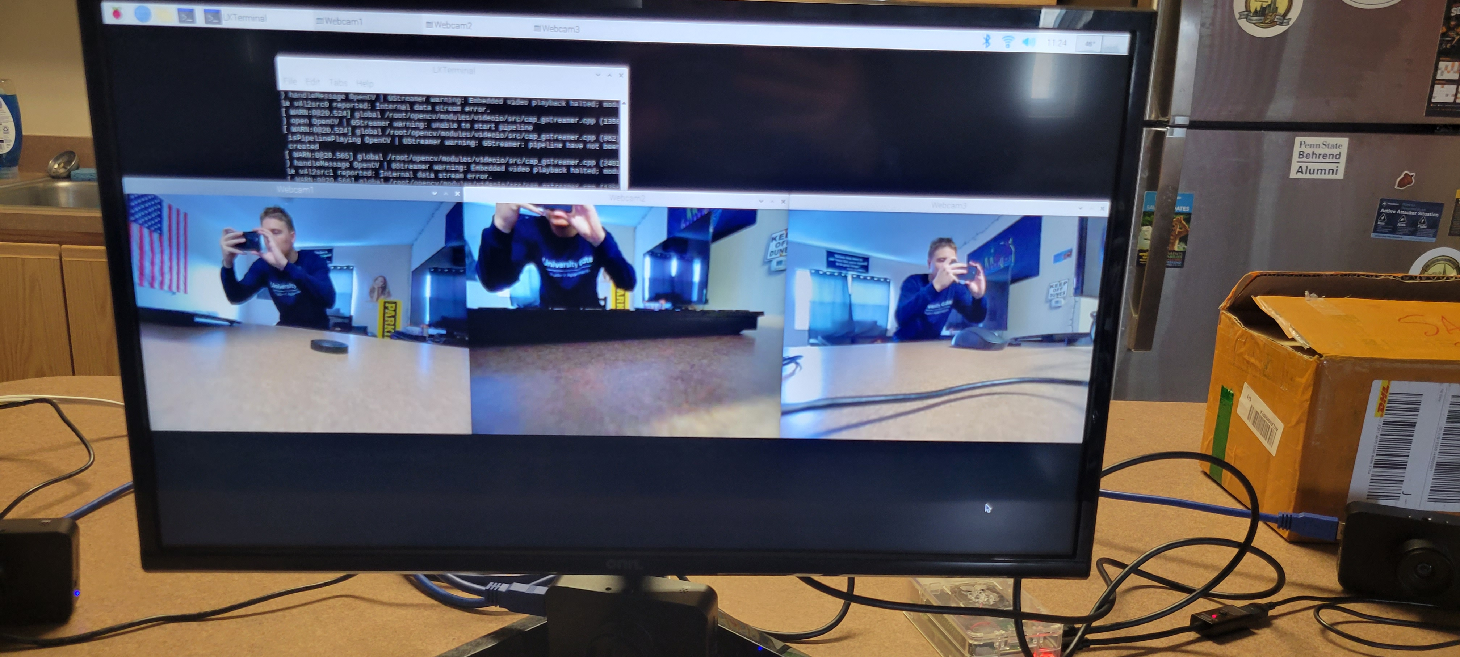
Final Output

Slide 17
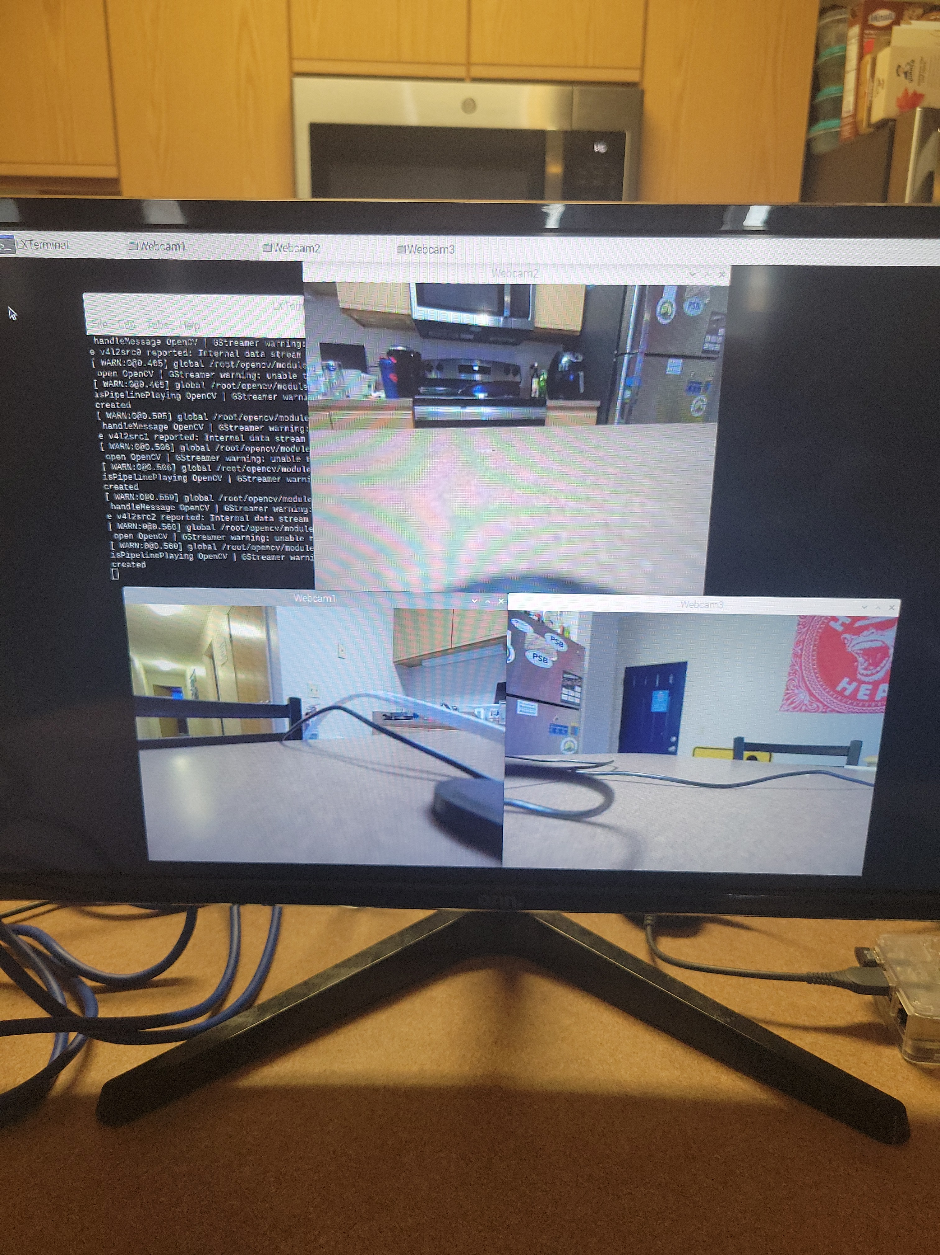
Other Possible Output
This way the SMV team has options as to how the cameras look

Slide 18
Logistical Problem
Budget restricted from acquiring a possible monitor

Slide 19
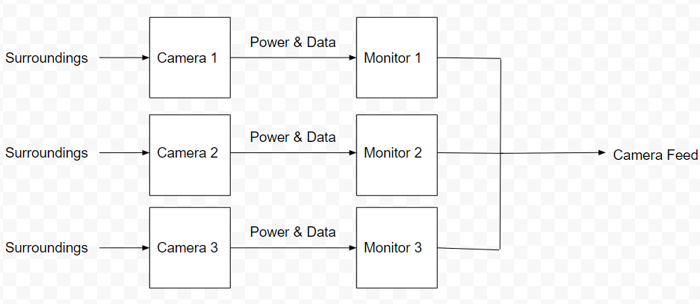
Alternative Designs
Three Cameras & 3 Monitors

Slide 20
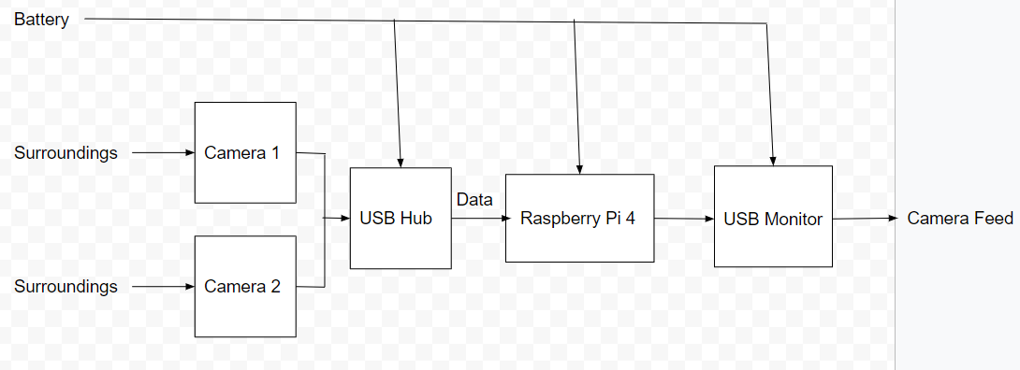
Alternative Designs
Two Cameras & 1 Monitor

Slide 21
Next Steps
Have SMV team test entire system
Implement system into vehicle

Slide 22
Conclusion
The SAE team works on a Super Mileage Vehicle every year to compete in a competition
The current method to see out of the vehicle can be difficult and unsafe
We are to create a camera system for the vehicle to be able to see the surrounding

Slide 23
Questions or Comments?

